Slide 1

Welcome

Slide 2
Name: V. Charumathi
Reg no: 22924u18002
NM id:EEF59EAF3FEBAEFB4E14268712CFC509
Department : B. Sc. [CS]
College:Sri Bharathi Women's Arts and Science College.
University: Thiruvalluvar University

Slide 3

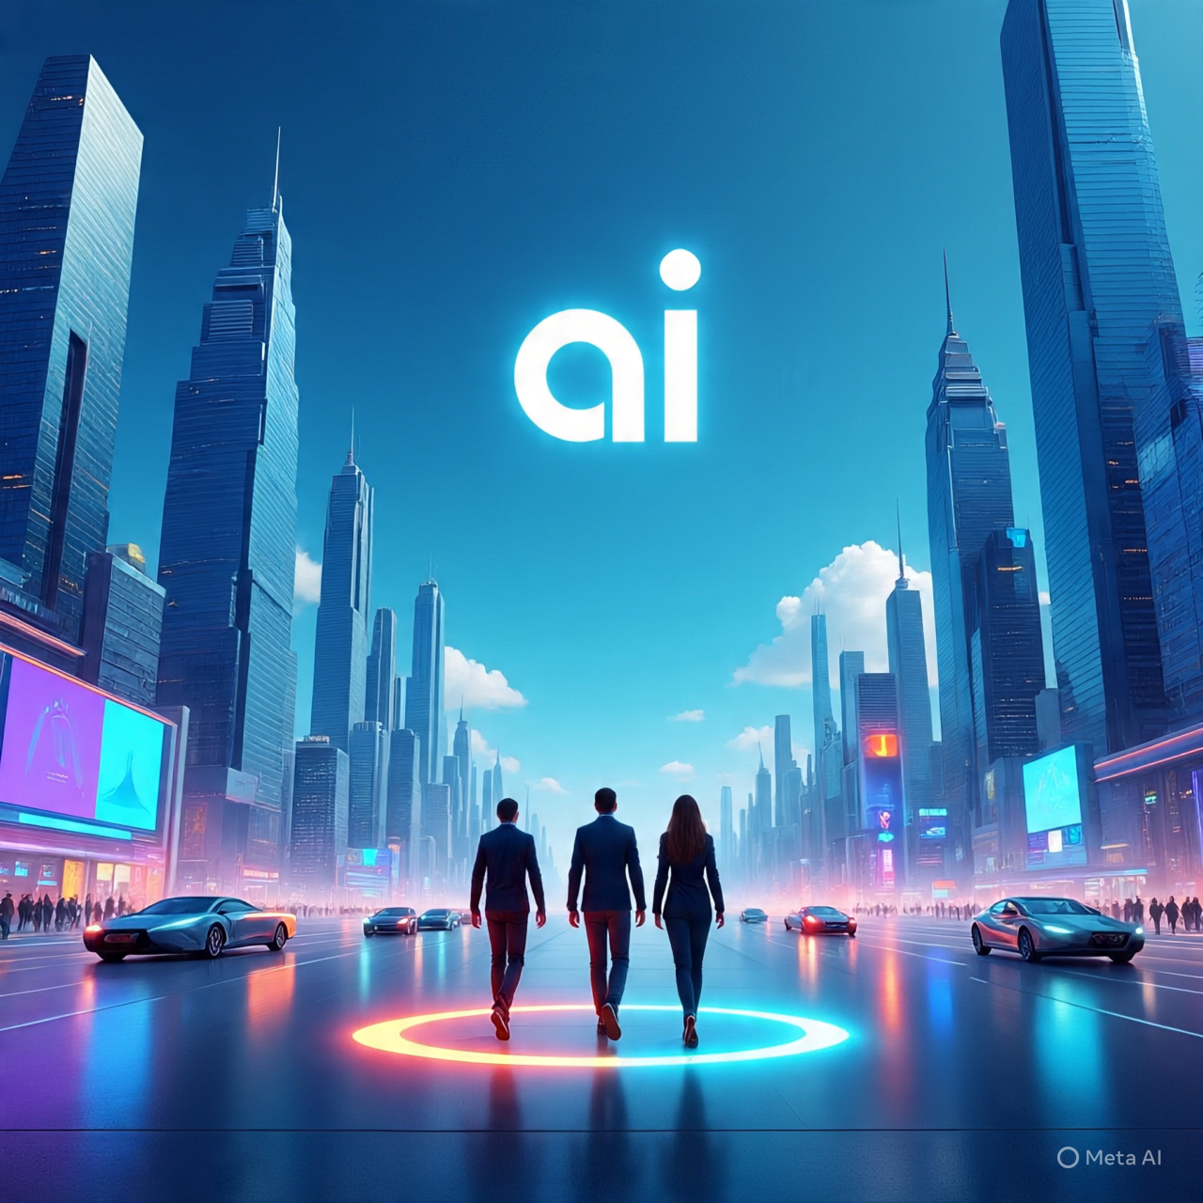

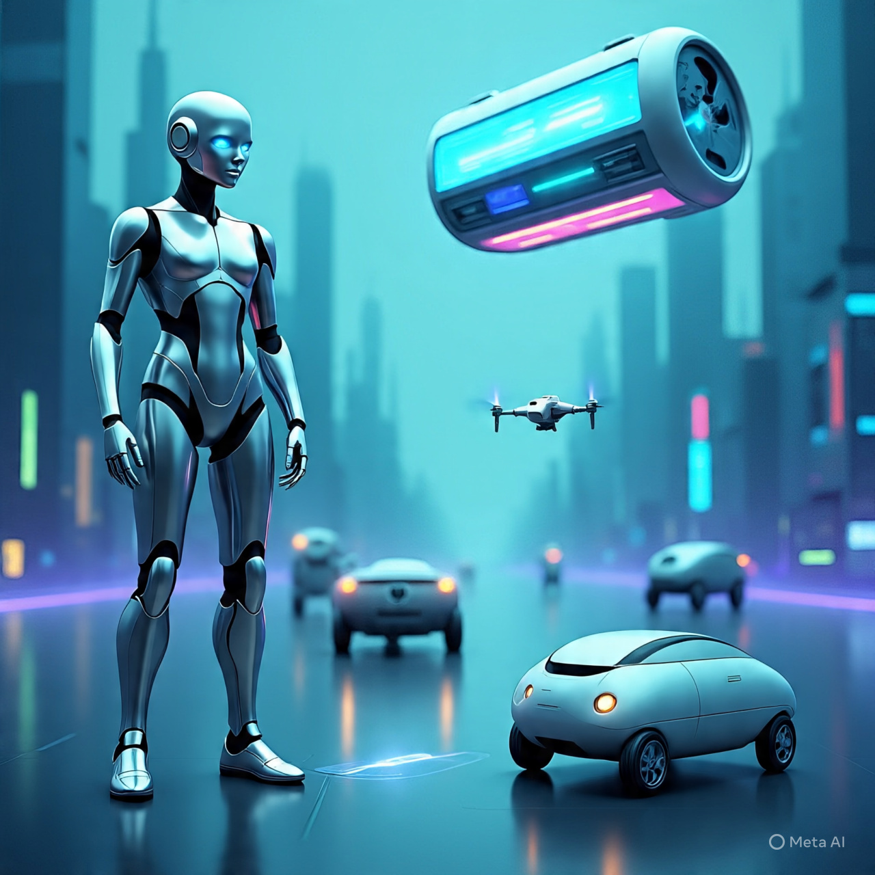
AI Technology overview

Slide 4
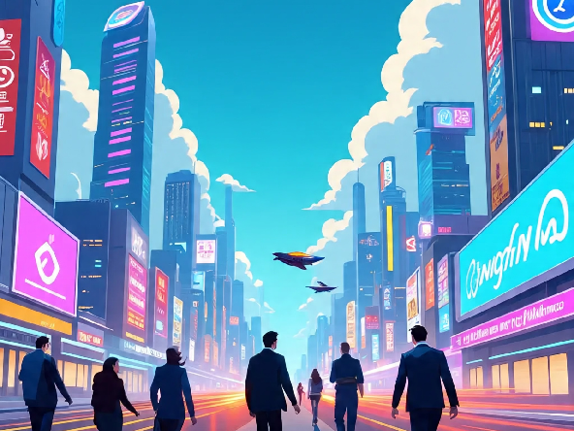
Artificial intelligence (AI) refers to the development of computer systems that can perform tasks that typically require human intelligence, such as learning, problem-solving, and decision-making.

Slide 5
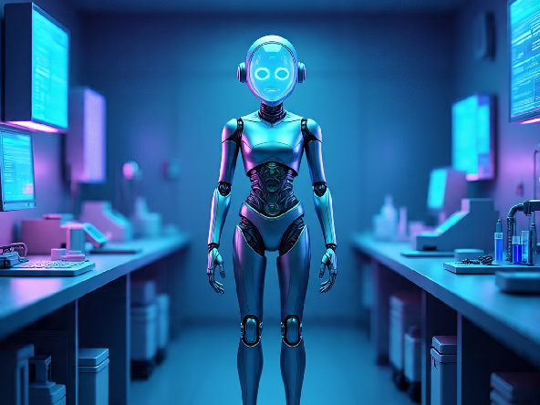
AI technology uses include virtual assistants, image recognition, natural language processing, and predictive analytics to automate tasks and improve decision-making.

Slide 6
IMPORTANT OF ARTIFICIAL INTELLIGENCE
AI is important because it can automate tasks, improve efficiency, enhance decision-making, and enable innovations in various industries like healthcare, finance, transportation, and more.

Slide 7
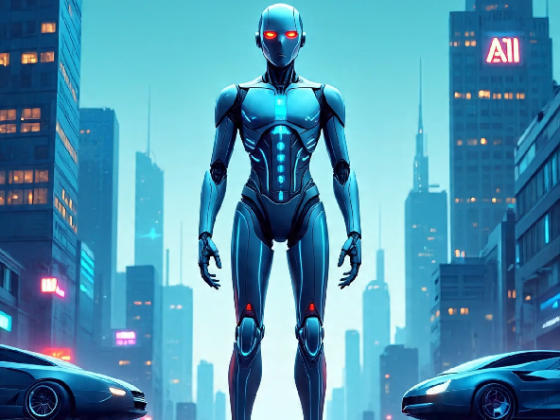
Image for Artificial intelligence

Slide 8
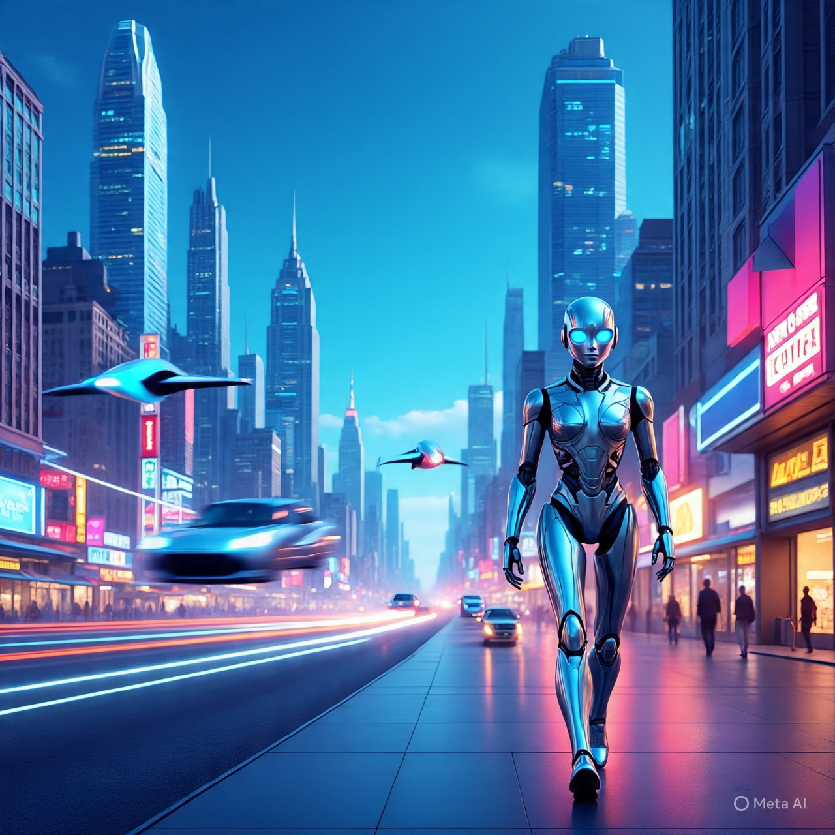
Future work for AI includes:
1. Advancing natural language processing
2. Improving computer vision
3. Developing explainable AI
4. Enhancing human-AI collaboration
5. Exploring applications in healthcare, finance, and education

Slide 9

Some challenges and limitations: 1. Bias and fairness 2. Data quality and availability 3. Explainability and transparency 4. Security and ethics 5. Job displacement and societal impact.

Slide 10

Applications of AI: 1. Virtual assistants (e.g., Siri, Alexa) 2. Image recognition (e.g., facial recognition, object detection) 3. Natural Language Processing (NLP) for chatbots and langu

Slide 11
Application and impact of AI
Applications of AI:
1. Virtual assistants (e.g., Siri, Alexa)
2. Image recognition (e.g., facial recognition, object detection)
3. Natural Language Processing (NLP) for chatbots and language translation
4. Predictive analytics for business and healthcare
5. Autonomous vehicles
Impact of AI:
1. Increased efficiency and productivity
2. Improved decision-making
3. Enhanced customer experiences
4. New business opportunities and innovations
5. Potential job displacement and skills shifts
Would you like more details on specific applications or impacts?

Slide 12

Future Artificial Intelligence
Future AI work will focus on developing more advanced and specialized models, improving transparency and explainability, and ensuring safe and responsible deployment.

Slide 13
AI's main features include learning, reasoning, problem-solving, perception, and natural language understanding.

Slide 14
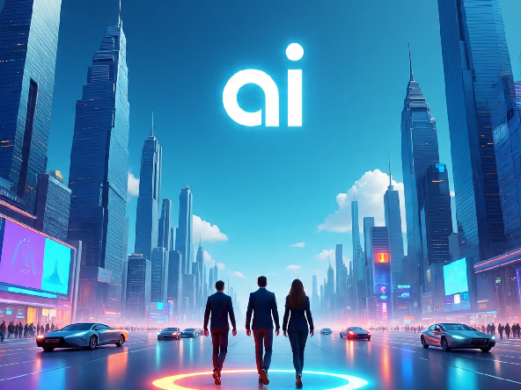
Benefits of Artificial Intelligence
AI benefits include increased efficiency, improved accuracy, enhanced decision-making, and personalized experiences.

Slide 15
Disadvantage of AI
1. *Job Displacement*: AI may automate jobs.
2. *Bias in Decision-Making*: AI systems can perpetuate and amplify.
3. *Security Risks*: AI systems can be vulnerable to cyber attacks and data breaches.
4. *Lack of Transparency*: AI decision-making procesess
5. *Dependence on Data Quality*: AI systems require high-quality data

Slide 16
Conclusion
AI has transformative potential, revolutionizing industries and improving lives, but requires responsible development and deployment.

Slide 17
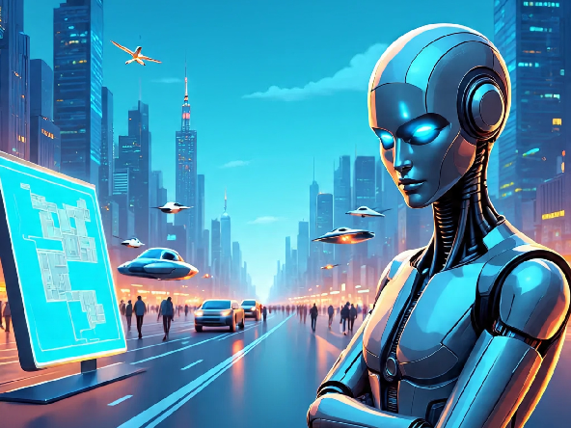

Slide 18
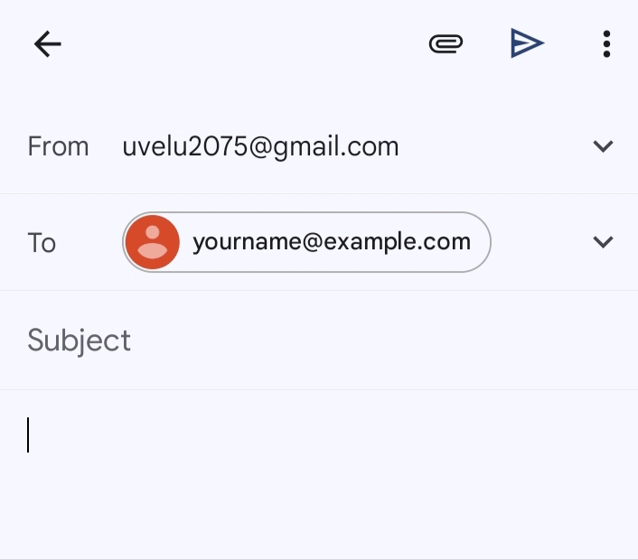
Coding for AI And output

Slide 19

Thank you

